Slide 1
Using Moodle

Slide 2

What is Moodle?
Face to face
teaching
Moodle is:
A learning management system …
For blended delivery …
With social constructivist pedagogy
Virtual
Learning
Environment

Slide 3
Why Use Moodle?
Stimulates student-centred learning
Supports teaching and learning
Allows differentiation of task
Encourages collaboration
Simplifies reporting and assessment
Supports progression to university and life-long learning.

Slide 4
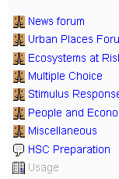

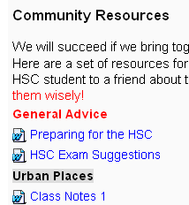

Moodle in Practice
1. Stimulates student-centred learning:
Forums
Community Resources
Student-produced material

Slide 5
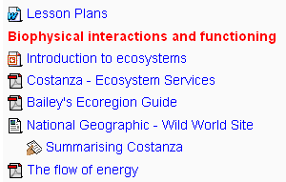
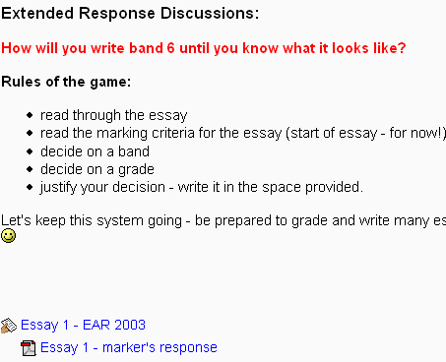

Moodle in Practice
2. Supports teaching and learning:
Centralised resources
Discussion facilities
Feedback

Slide 6
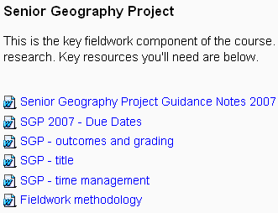

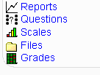
Moodle in Practice
3. Allows differentiation of tasks:
Individualised work
Grades and outcomes
Self-pacing

Slide 7

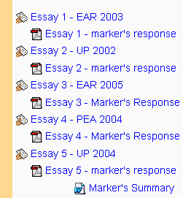
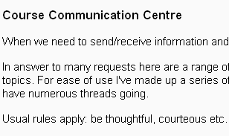
Moodle in Practice
4. Encourages collaboration:
Wiki
Group work
Community

Slide 8
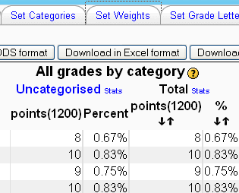
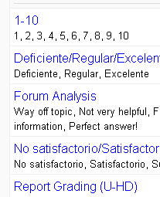
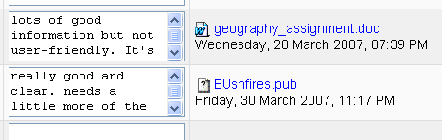
Moodle in Practice
5. Simplifies reporting and assessment:
Powerful grade book
Student grade-emails
Customisable

Slide 9
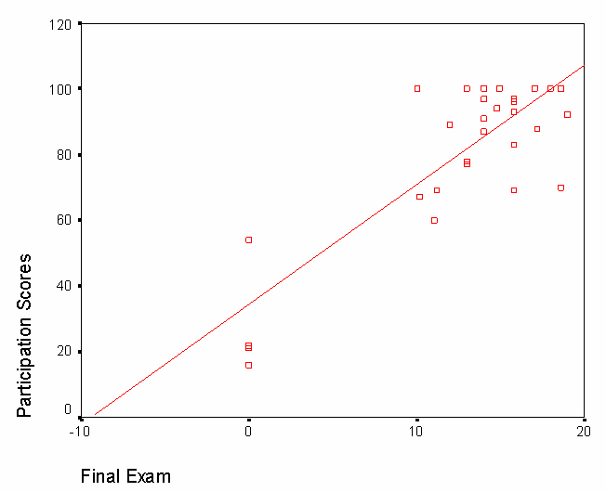
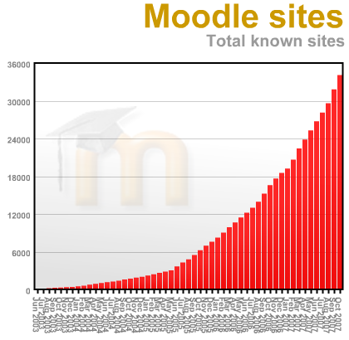
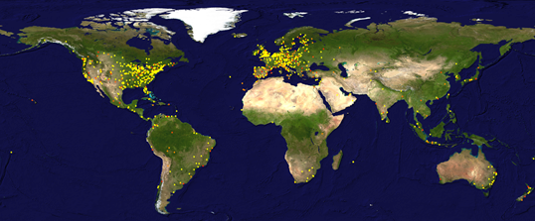
Moodle in Practice
6. Supports progression to university and life-long learning:
Notes:
Moodle sites – up to 35000
Map – deployment of Moodle to Oct 2007
Graph – study of participation vs grade score for use of VLE – 2005, Humboldt Uni, USA – Blackboard vs Moodle.

Slide 10
To take-away:
Planning
Pedagogy
Progression

Slide 11



Thank you
Life
Before
Moodle
Life
After
Moodle
© PSG 2007

