Slide 1
Installing and Configuring Moodle

Slide 2
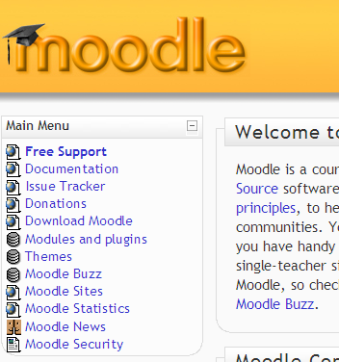
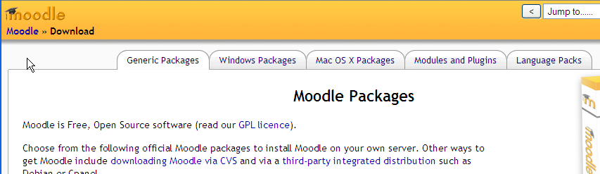
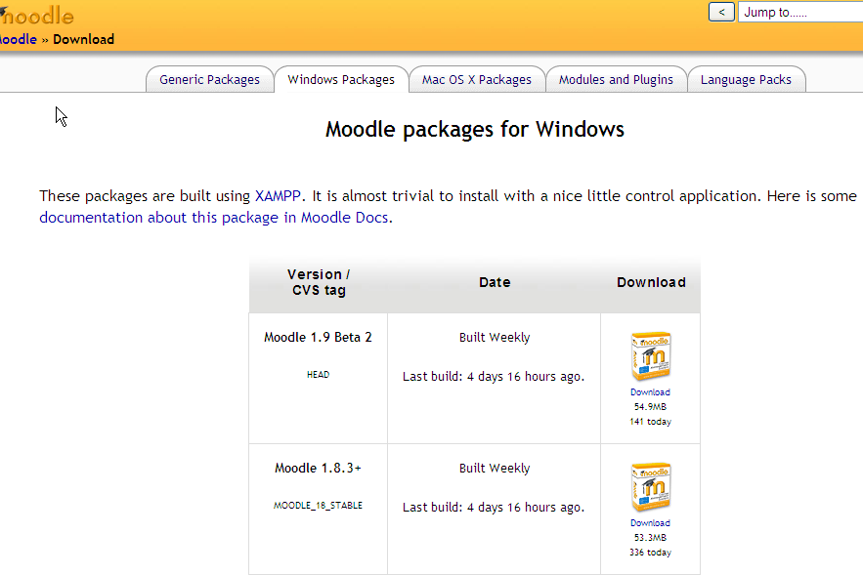
Download
Download latest Windows Install package from Moodle.org

Slide 3
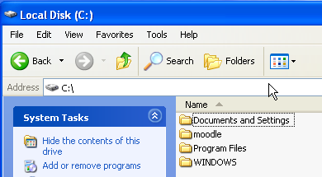
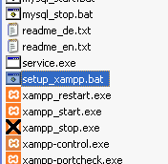
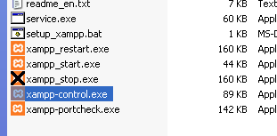
Setup
Extract zip and copy moodle folder to C:\
Run setup_xampp to change paths
Then start xampp-control to configure services

Slide 4
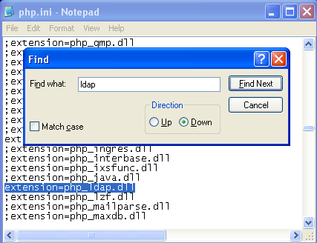
Setup – Enable LDAP
You need to enable LDAP in XAMPP
Open C:\moodle\apache\bin\php.ini
Find “ldap” and remove “;” at start of line

Slide 5
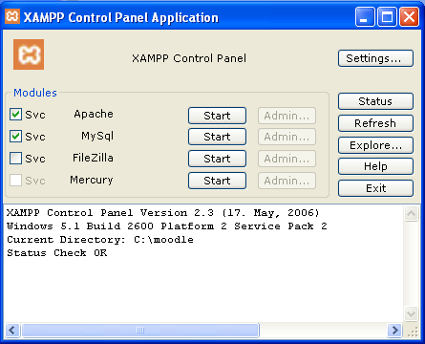
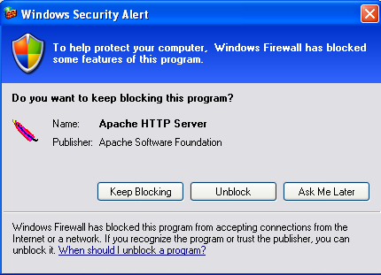
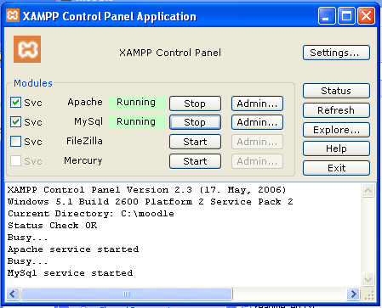
Service Installation
To have Moodle start automatically
  Tick the SVC box next to Apache and MySql
  Then click the start buttons next to them

Slide 6
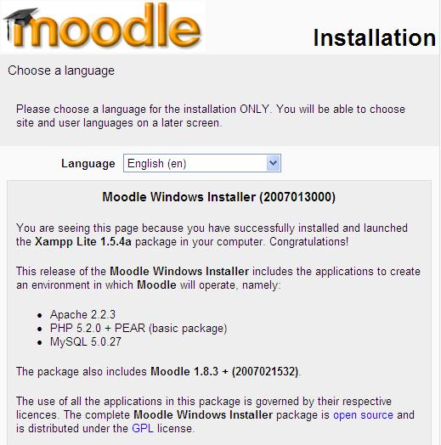

Initial Installation
Start up your web browser and type in localhost
Go through screens clicking next and filling in school details as required.
You may wish to change data directory to a different drive with more space.

Slide 7
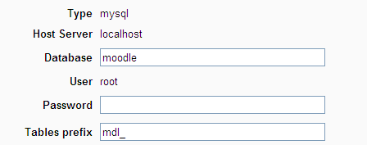
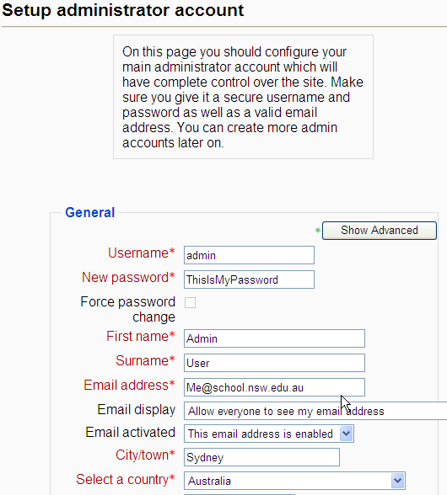
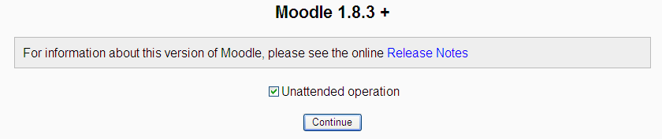
First Run

Slide 8
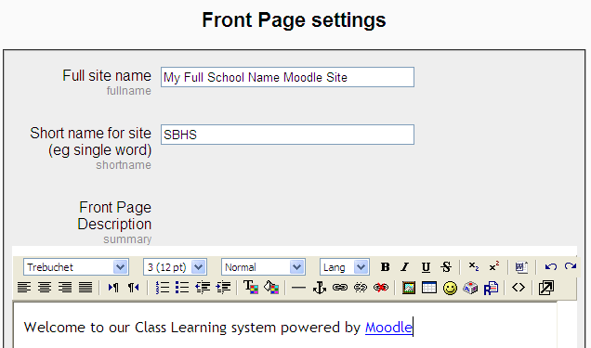

Front Page Settings

Slide 9
Moodle Cron
Moodle has several scripts that run automatically, such as backup, enrolment, etc.
To make this work on windows you need to install an extra program.
http://docs.moodle.org/en/Cron
http://download.moodle.org/download.php/
sourceforge/MoodleCron-Setup.exe

Slide 10
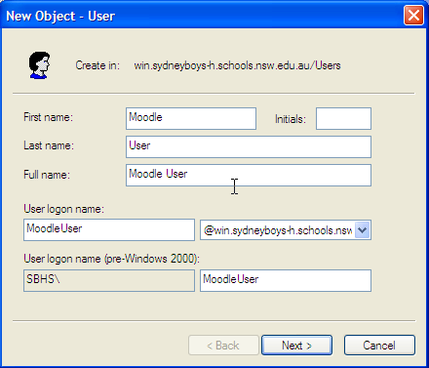
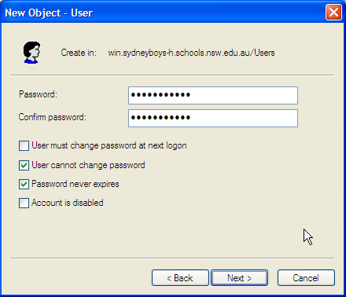
User Authentication - AD
Allow users to use their existing login details
Need to connect to Active Directory (AD) using LDAP
Add a new AD user to use with Moodle

Slide 11
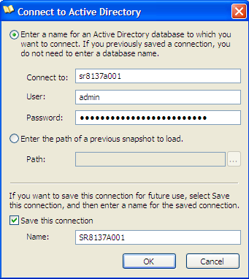
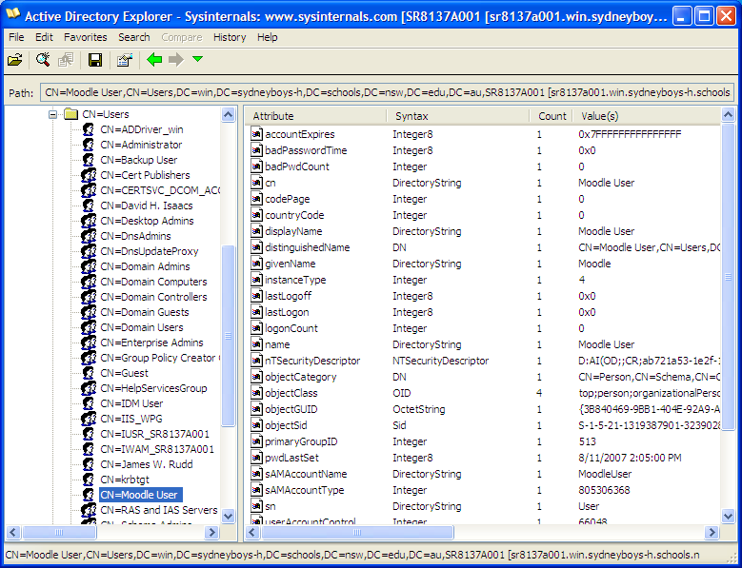
User Authentication -AD
Download AD Explorer from SysInternals
www.sysinternals.com -> Networking Utilities
Start and add your domain controller (Main Server)

Slide 12
User Authentication -AD
Browse to where you created Moodle user
Copy the Path of the user, eg
CN=Moodle User,CN=Users,DC=win,DC=sydneyboys-h,DC=schools,DC=nsw,DC=edu,DC=au

Slide 13
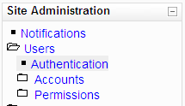
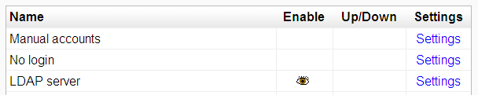
User Authentication - Moodle
Login to Moodle site as Admin
In Authentication enable LDAP and disable Email
Click LDAP Settings

Slide 14
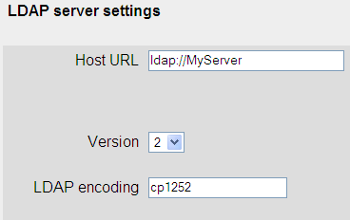
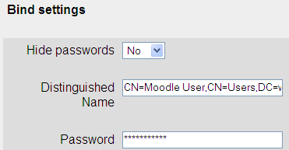
User Authentication - Moodle
Click LDAP Settings
Type in school specific details
Paste in the path of the Moodle User
Paste in the path of the Moodle User and type in their password

Slide 15
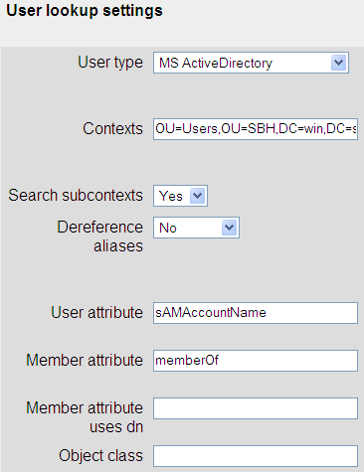
User Authentication - Moodle
Using AD Explorer copy the path of the container holding all your staff and student users
Paste into the Contexts option

Slide 16

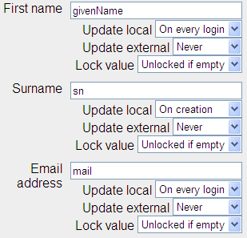
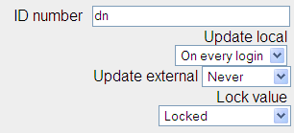
User Authentication - Moodle
Do the same again for a group you wish to use to create courses.
Then set the Data Mapping options as shown.

Slide 17
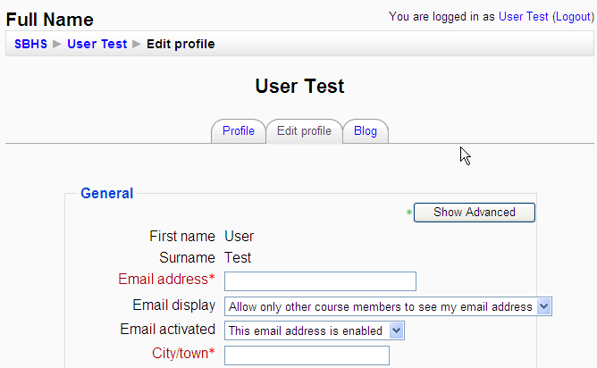
User Authentication - Moodle
Now when users login to Moodle with their network username and password for the first time it will prompt them to fill in their details for their new account.
Note the locked items from previous page cannot be changed

Slide 18
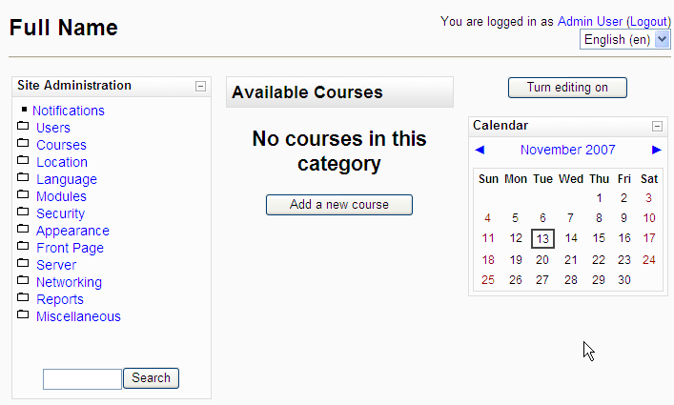
Creating a Course
Click on Add a new course

Slide 19
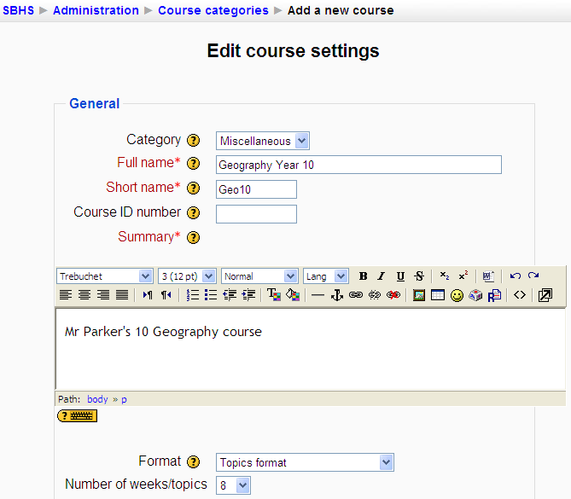
Course Settings
Fill in class name, an abbreviated name and summary.
Change the format to Topics if preferred.

Slide 20
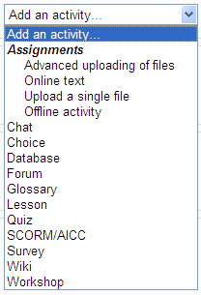

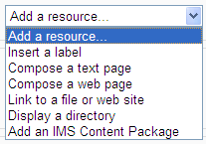
Adding Course Content
Click the short class name to return to class.
Click Turn editing on to modify the course and add content
Add resources or activities as desired

Slide 21
Useful Links
Moodle Links
  http://docs.moodle.org/en/Installing_AMP#Windows
  http://docs.moodle.org/en/LDAP_authentication
  http://docs.moodle.org/en/Cron
  http://download.moodle.org/download.php/
  sourceforge/MoodleCron-Setup.exe
  http://docs.moodle.org/en/Using_Moodle_book
  http://download.moodle.org/docs/teacher-manual.pdf
  http://moodle.tokem.fi/
Other
  http://www.microsoft.com/technet/sysinternals/
  Networking/AdExplorer.mspx

